Slide 1

Chapter 15
Connecting LANs,
Backbone Networks,
and Virtual LANs
15.<number>
Copyright © The McGraw-Hill Companies, Inc. Permission required for reproduction or display.

Slide 2
Network Hardware
Network linking devices
  Connect nodes in the network
  Cable runs from node to device
  Crossover cable connects two computers
9A-<number>

Slide 3
Network Hardware
Hubs
  Center of a star network
  All nodes receive transmitted packets
  Slow and insecure
9A-<number>

Slide 4
Network Hardware
Switches
  Replacement for hubs
  Only intended node receives transmission
  Fast and secure
9A-<number>
Notes:
Insider information
Twisted pair networks cannot achieve higher than 10 Mbps using a hub. Switches are necessary to achieve 100 Mbps or higher.

Slide 5
Network Hardware
Bridge
  Connects two or more LANs together
  Packets sent to remote LAN cross
    Other packets do not cross
  Segments the network on MAC addresses
9A-<number>

Slide 6

Network Hardware
Router
  Connects two or more LANs together
  Packets sent to remote LAN cross
  Network is segmented by IP address
  Connect internal networks to the Internet
  Need configured before installation
9A-<number>
Notes:
Discussion point
Ask who in the class has high speed Internet. Then determine if anyone is sharing this to the rest of the house or dorm. If they are, see if they can describe the setup. Most likely, the sharing is done with a router.

Slide 7
Network Hardware
Gateway
  Connects two dissimilar networks
  Connects coax to twisted pair
  Most gateways contained in other devices
9A-<number>

Slide 8
15-1 CONNECTING DEVICES
In this section, we divide connecting devices into five different categories based on the layer in which they operate in a network.
Topics discussed in this section:
Passive Hubs
Active Hubs
Bridges
Two-Layer Switches
Routers
Three-Layer Switches
Gateways
15.<number>

Slide 9

Figure 15.1 Five categories of connecting devices
15.<number>

Slide 10

Figure 15.2 A repeater connecting two segments of a LAN
15.<number>

Slide 11

Note
A repeater connects segments of a LAN.
15.<number>

Slide 12
Note
A repeater forwards every frame;
it has no filtering capability.
15.<number>

Slide 13
Note
A repeater is a regenerator,
not an amplifier.
15.<number>

Slide 14

Figure 15.3 Function of a repeater
15.<number>

Slide 15

Figure 15.4 A hierarchy of hubs
15.<number>

Slide 16
Note
A bridge has a table used in
filtering decisions.
15.<number>

Slide 17

Figure 15.5 A bridge connecting two LANs
15.<number>

Slide 18
Note
A bridge does not change the physical (MAC) addresses in a frame.
15.<number>

Slide 19

Figure 15.6 A learning bridge and the process of learning
15.<number>

Slide 20

Figure 15.11 Routers connecting independent LANs and WANs
15.<number>

Slide 21
15-2 BACKBONE NETWORKS
A backbone network allows several LANs to be connected. In a backbone network, no station is directly connected to the backbone; the stations are part of a LAN, and the backbone connects the LANs.
Topics discussed in this section:
Bus Backbone
Star Backbone
Connecting Remote LANs
15.<number>

Slide 22
Note
In a bus backbone, the topology
of the backbone is a bus.
15.<number>

Slide 23
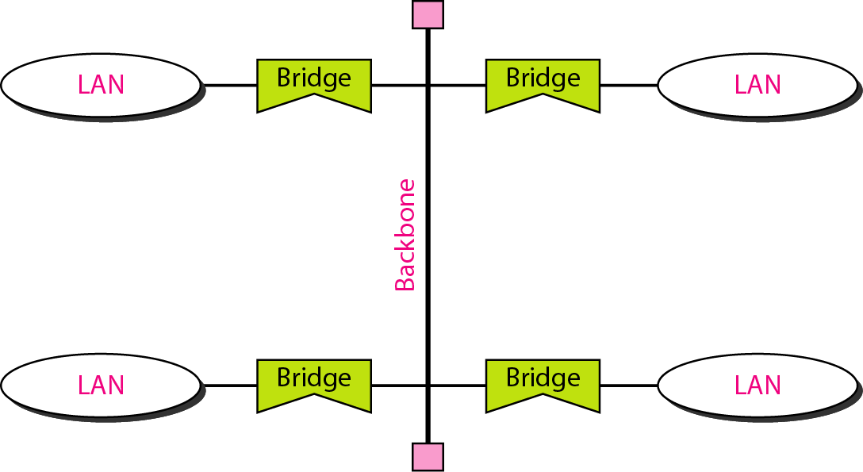
Figure 15.12 Bus backbone
15.<number>

Slide 24
Note
In a star backbone, the topology of the backbone is a star;
the backbone is just one switch.
15.<number>

Slide 25
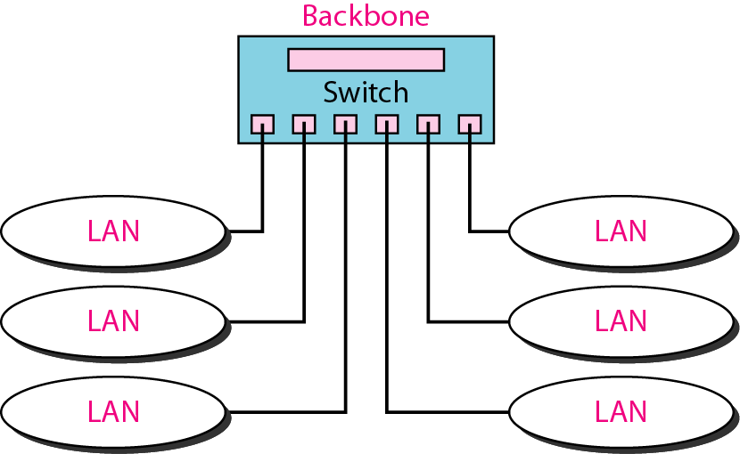
Figure 15.13 Star backbone
15.<number>

Slide 26
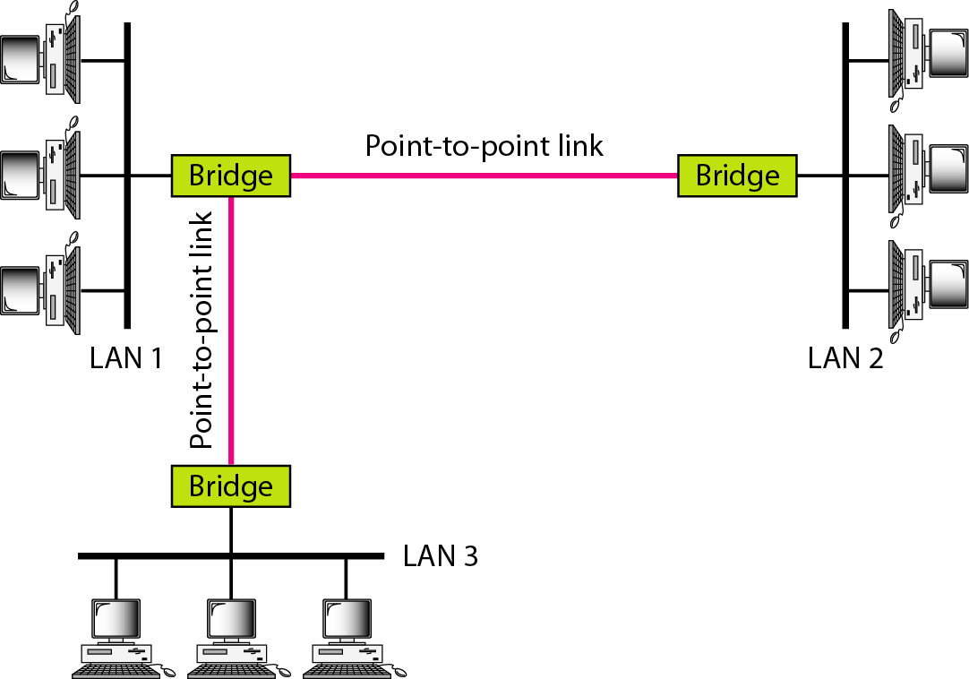
Figure 15.14 Connecting remote LANs with bridges
15.<number>

Slide 27
Note
A point-to-point link acts as a LAN in a remote backbone connected by
remote bridges.
15.<number>

Slide 28
15-3 VIRTUAL LANs
We can roughly define a virtual local area network (VLAN) as a local area network configured by software, not by physical wiring.
Topics discussed in this section:
Membership
Configuration
Communication between Switches
IEEE Standard
Advantages
15.<number>

Slide 29
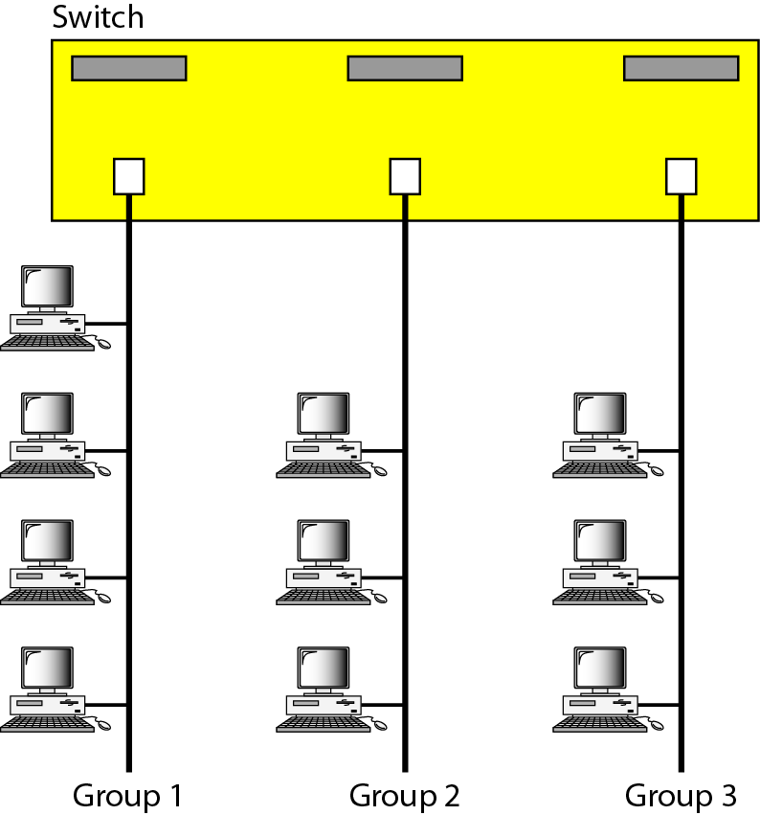
Figure 15.15 A switch connecting three LANs
15.<number>

Slide 30

Figure 15.16 A switch using VLAN software
15.<number>

Slide 31

Figure 15.17 Two switches in a backbone using VLAN software
15.<number>

Slide 32
Note
VLANs create broadcast domains.
15.<number>

